Slide 1
GBS
TARUS-MBChB V

Slide 2
OUTLINE
Introduction
Etiology
Pathogenesis
Clinical features
Differential diagnosis
Investigations
Asbury criteria for GBS diagnosis
Treatment
Summary

Slide 3
INTRODUCTION
Organization of the nervous system
Neuron structure-fxns of myelin sheath
Upper motor lesion vs lower motor lesion
CNS exam
HC-consciousness, orientation, cognition (memory, intellect, concentration, judgement), appearance and behaviour .
Speech
CNs
Meningism-neck softness, kerning, brudnziski
Motor- bulk, tone, power , reflexes , cerebellar fxn( coordination[heel shin ,dysdiadokokinesia , rhombergs test , past-pointing] ,gait- sparstic hemiplegic gait,festinant, waddling, shuffling, sensory cerebellar ataxia. ), involuntary mvt
Sensory- pain, temperature, crude touch; position sense vibration & fine touch ; recognition of size, weight and form; two point discrimination

Slide 4
Introduction
TERMS
Dysesthesias – an UNPLEASANT ABNORMAL sensation produced by NORMAL stimuli.
Paresthesias – an abnormal sensation in ABSENCE of external stimulus.
Allodynia – pain from NON NOXIOUS STIMULUS to normal skin.
Hyperpathia – abnormal EXAGGERATED response to PAINFUL stimuli.

Slide 5
INTRODUCTION

Slide 6
A typical neuron possesses a cell body (often called the soma), dendrites, and an axon.
Dendrites are thin structures that arise from the cell body, a complex "dendritic tree".
An axon is a special cellular extension that arises from the cell body at a site called the axon hillock .
The cell body of a neuron frequently gives rise to multiple dendrites, but never to more than one axon, although the axon may branch hundreds of times before it terminates. one neuron to a dendrite of another.
exceptions to these rules: neurons that lack dendrites, neurons that have no axon, synapses that connect an axon to another axon or a dendrite to another dendrite, etc.

Slide 7
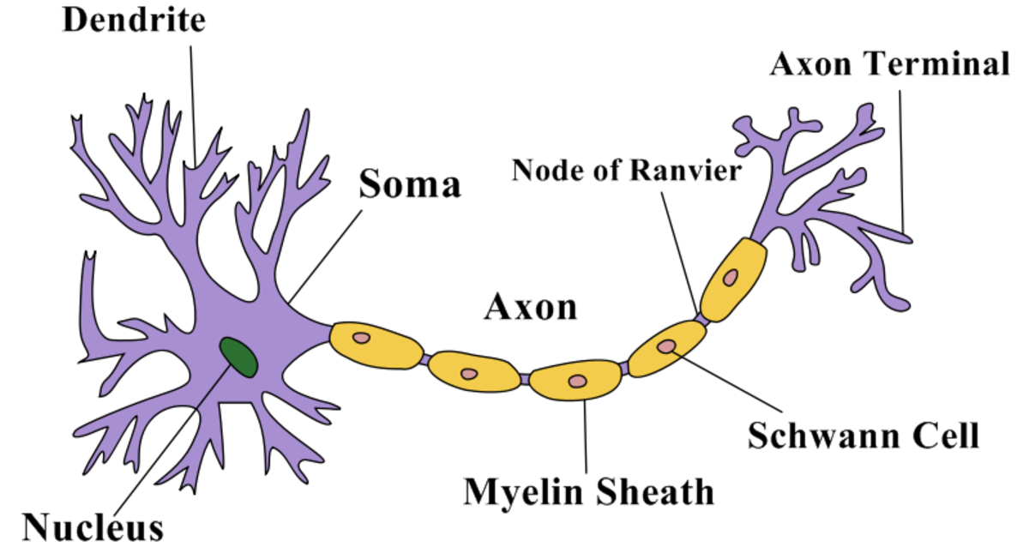
INTRODUCTION
At the majority of synapses, signals are sent from the axon of
The Neuron Structure

Slide 8
INTRODUCTION
GANGLIOSIDES: Glycoconjugates
Complex glycosphingolipids
One or more sialic acid residues.
Involved in cell-cell interactions, modulation of receptors, regulation of growth.
Seen on plasma membrane of cells.
Abundant in human nervous tissue, nodes of Ranvier.
Targets for antibody mediated attack

Slide 9
INTRODUCTION
Demyelination
A demyelinating disease is any disease of the nervous system in which the myelin sheath of neurons is damaged.
This impairs the conduction of signals in the affected nerves, causing impairment in sensation, movement, cognition, or other functions depending on which nerves are involved.
Conditions associated with acute demyelination include; optic neuritis, acute transverse myelitis,acute disseminated encephalomyelitis(ADEM)

Slide 10
INTRODUCTION
AUTOIMMUNITY; concept of molecular mimicry

Slide 11
INTRODUCTION
Georges Gullain and Jean Barre-1916
Toe to Nose; ascending
Symetrical
Acute monophasic
Non-febrile
Preceeded by git or resp infection
Progression over days to weeks
Maybe-CNs dysfuxtion,autonomic dysfxn and sensory disturbances
Abn electrodx

Slide 12
ETIOLOGY
70% cases –post infectious .
1-3 weeks after an acute infectious process of the respiratory or GIT systems.
20-30% cases –Campylobacter jejuni
Other agents –EBV,CMV
Mycoplasma pneumoniae
Helicobacter pylori
Recent immunisation –swine influenza vaccine, older rabies vaccine (nervous system)
Can be seen in patients with lymphoma, HIV, SLE.

Slide 13
PATHOGENESIS
An autoimmune basis.
Both cellular and humoral immunity involved.
T cells activation – IL2, IL-6, TNF alpha, IFN gamma.
All GBS results from immune responses to non-self antigens (infectious agents, vaccines) that misdirect to host nerve tissue through a resemblance of epitope (molecular mimicry).
Neural targets are gangliosides.
Anti ganglioside antibody –GM1 (20-50% cases of C.jejuni)
Anti GQ1b antibody - >90% Miller Fisher Syndrome

Slide 14
GM1 on nerve, nodes of Ranvier
Anti GM1 antibody as part of molecular mimicry
Complement mediated injury at Paranodal axon – glial junction
Disrupts the cluster of sodium channels
Nerve Conduction block
Flaccid paralysis

Slide 15
SUBTYPES OF GBS
Acute inflammatory demyelinating polyneuropathy
Acute motor axonal neuropathy
Acute motor sensory neuropathy
Miller fisher syndrome
Pharyngeal cervical brachial variant
Others-polyneuritis cranialis,acute pandysautonomia,chronic progressing neuropathy, chronic relapsing demyelinating neuropathy

Slide 16
ACUTE INFLAMMATORY DEMYELINATING POLYNEUROPATHY (AIDP)
Affects adults > children
Rapid recovery
Anti GM1 antibody (50%)
Demyelinating
First attack on Schwann cell surface
Widespread myelin damage
Lymphocyte infiltration
Variable secondary axonal damage

Slide 17
AMAN (ACUTE MOTOR AXONAL NEUROPATHY)
Children ,young adults
Seasonal
Recovery rapid
Anti GD1a antibody
Axonal degeneration (axonal damage is variable)
First attack on motor nodes of Ranvier
Macrophage activation

Slide 18
MILLER FISCHER VARIANT
Affects adults and children
Uncommon
Classic triad: Ophthalmoplegia, ataxia and areflexia
Anti GQ 1b antibodies >90% (Not seen in other forms of GBS unless there is extraocular muscle invovlement)

Slide 19
MILLER FISCHER VARIANT
More of GQ1b gangliosides in extraocular muscle
Cause conduction block
Pupillary paralysis
Only 5% of GBS

Slide 20
CLINICAL FEATURES
History
Respiratory or GI tract infection prior to onset of weakness – 1-3 weeks.
History of recent immunisation (rabies)
Sudden or progressive weakness over 2-3 days.
NO FEVER AT THE ONSET OF WEAKNESS.
FEVER AND CONSTITUTIONAL SYMPTOMS ARE ABSENT AT THE ONSET AND IF PRESENT ,CAST DOUBT ON DIAGNOSIS.

Slide 21
CLINICAL FEATURES
MOTOR SYSTEM :
Rapidly evolving areflexic motor paralysis with or without sensory disturbance.
Ascending type of paralysis
RUBBERY LEGS.
Weakness evolves over hours to days.
Legs affected more than arms
Accompanied by dysesthesias of extremities.
DEEP TENDON REFLEXES:
Reflexes attenuate, disappear in few days of onset.

Slide 22
CLINICAL FEATURES
CRANIAL NERVES:
Facial diparesis seen in 50% affected individuals.
Lower cranial nerves affected –bulbar weakness – difficulty in handling secretions, maintaining airway.
Ophthalmoplegia –Miller Fischer variant
Pupillary paralysis
Optic atrophy

Slide 23
CLINICAL FEATURES
SENSORY SYSTEM:
Largely myelinated fibres are severely affected.
Proprioception is more affected than pain or temperature sensation.
BLADDER:
Only in severe cases, transiently.
If bladder dysfunction is a prominent feature and comes early in the course, think other diagnosis than GBS – spinal cord disease.

Slide 24
CLINICAL FEATURES
PAIN:
Deep aching pain may be present the previous day in weakened muscles.
Initially at onset – neck, shoulder, back, diffusely over spine -50% cases.
Dysesthetic pain in extremities
Usually self limited
Responds to analgesics

Slide 25
CLINICAL FEATURES
AUTONOMIC INVOLVEMENT:
Common
Seen even in mild cases
Wide fluctuation in blood pressure
Postural hypotension
Cardiac dysrryhthmias
Close monitoring and management needed
Can be fatal.

Slide 26
CLINICAL FEATURES
Symptom progression: Motor weakness rapidly progresses initially but ceases by 4 weeks. Nadir attained by 2 weeks in 50%, 3 weeks 80%, and 90% by 4 weeks.

Slide 27
ASBURY CRITERIA FOR DIAGNOSIS
REQUIRED :
#1. Progressive weakness of 2 or more limbs
due to neuropathy.
#2. Areflexia
#3. Disease course < 4 weeks
#4. Exclusion of other causes (vasculitis, Polyarteritis Nodosa, SLE, Churg strauss syndrome, toxins, lead, botulism, diptheria, porphyria, cauda equinal syndrome)

Slide 28
ASBURY CRITERIA
SUPPORTIVE:
#1. Relatively symmetric weakness
#2. Mild sensory involvement
#3. Facial nerve or other cranial nerve
involvement
#4. Absence of fever
#5. Typical CSF profile (acellular, increase in
protein level)
#6. Electrophysiologic evidence of
demyelination
Modified ASBURY CRITERIA

Slide 29
DIFFERENTIAL DIAGNOSIS
Acute myelopathy – back pain, sphincter disturbances
Botulism –early loss of pupillary activity, descending paralysis
Diphtheria –early oropharyngeal involvement
Lyme disease polyradiculitis
Porphyria –abdominal pain,seizure, psychosis
Vasculitic neuropathy

Slide 30
DIFFERENTIAL DIAGNOSIS
Poliomyelitis (with fever, meningeal signs)
Brain stem ischemia
Critical illness neuropathy
Myasthenia gravis
Organophosphate poisoning

Slide 31
INVESTIGATIONS
CSF :
Raised CSF protein 1-10 g/l (100-1000mg/dl)
Without accompanied by pleocytosis
CYTOALBUMINOLOGICAL DISSOSCIATION
Usually normal in <48 hrs
Increased proteins at the end of first week
Think of HIV ,CMV in case of pleocytosis.

Slide 32
INVESTIGATIONS
ELECTRODIAGNOSTIC TESTS:
May be normal
Lags behind clinical events
Demyelination - Prolonged distal latencies, conduction velocity slowing, conduction block.
Reduced amplitude of compound action potential without conduction slowing

Slide 33
TREATMENT
All require hospitalisation
Initiate Rx as soon as possible, each day counts
2 weeks after the first motor symptoms –
immunotherapy is no longer effective.
IVIG ( Intravenous Immunoglobulin)
Plasmapheresis
Combination is not effective

Slide 34
TREATMENT
IVIG - first choice, easy to administer
Five daily (each day)infusions to total 2g/kg body weight (i.e, 0.4mg/kg/day)
Plasmapheresis
40-50ml/kg four times a week
Treatment reduces the need for ventilation by half, increases full recovery at an year.
Glucocorticoids (steroids) are not effective in GBS.
Conservative management in mild cases.

Slide 35
TREATMENT
Severe Cases
Critical care setting (ICU, HDU)
Attention to vital capacity, heart rhythm, blood pressure, nutrition, DVT, cardiovascular status, tracheotomy, chest physiotherapy.
30% require ventilation, some for prolonged periods
Physiotherapy is also important.

Slide 36
PROGNOSIS/ FOLLOW UP
Approximately 85% of patients with GBS achieve a full functional recovery within several months to a year,
Minor findings on examination (such as areflexia) may persist and patients often complain of continued symptoms, including fatigue.
The mortality rate is <5% in optimal settings; death usually results from secondary pulmonary complications. The outlook is worst in patients with severe proximal motor and sensory axonal damage.

Slide 37
SUMMARY
Acute rapidly evolving areflexic ascending motor paralysis with or without sensory disturbances.
Fever is absent at the onset of weakness
Bladder involvement in severe cases – transient
Campylobacter jejuni 20-30 % cases

Slide 38
SUMMARY
Autoimmune basis, molecular mimicry
Anti GM1 antibody (MC),anti GD1a,anti GQ1b (MFS)
Autonomic involvement is common
Facial nerve is the one most commonly affected cranial nerve, optic nerve may also be affected.
30% require ventilatory support.

Slide 39
SUMMARY
Course is usually < 4 weeks
Typical CSF profile shows high protein, no pleocytosis
Electrographically conduction block present
Treatment as soon as possible

Slide 40
SUMMARY
IVIG, plasmapheresis –both are equally good
Glucocorticoids are not effective in GBS
Think of Miller fischer variant in presence of ophthalmoplegia, ataxia, areflexia.

